Slide 1
INFORMATION RETRIEVAL SYSTEMS (IRS)
Course Instructor
P.Veera Swamy
Assistant Professor

Slide 2
UNIT-5 SYLLABUS
Text Search Algorithms:
Introduction
Software text search algorithms
Hardware text search systems
Information System Evaluation:
Introduction
Measures used in system evaluation
Measurement example – TREC results.

Slide 3
OVERVIEW
Three classical techniques for text retrieval techniques have been defined for organizing items in a textual database, for rapidly identifying the relevant items and for eliminating items that do not satisfy the search.
Full text scanning (streaming)
Word inversion and
Multi-attribute retrieval
most text search is performed by software, But in the earlier history of information systems, where the limited capabilities of hardware (CPU power, memory and disk systems) restricted search applications, specialized hardware text search systems were created.

Slide 4
INTRODUCTION TO TEXT SEARCH TECHNIQUES
The basic concept of a text scanning system is the ability for one or more users to enter queries with the text of the items to be searched sequentially accessed and compared to the query terms. When all of the text has been accessed, the query is complete.
Streaming of text is a sequential search of the text.
This technique is used to complete a query by searching for query terms that could not be satisfied by the index (e.g., imbedded search terms).
It is also frequently used to locate the search terms for highlighting in the retrieved item prior to display.

Slide 5
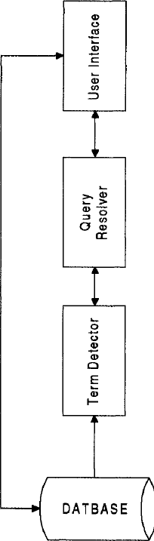
Text Streaming Architecture

Slide 6
The database contains the full text of the items.
The term detector is the special hardware/software that contains all of the search terms and in some systems the logic between the terms.
It inputs the text and detects the existence of the search terms. logic between the terms. It inputs the text and detects the existence of the search.
The query resolver performs two major functions:
Accepting search statements from the users.
Extracting the logic and search terms to pass to the detector.
It also accepts results from the detector and determines which queries are satisfied by the item and possibly the relevance weight associated with hit.

Slide 7
The query resolver passes information to the user interface, allowing it to continually update the search status and, on request, retrieve any items that satisfy the user search statement.
The text streaming process is focused on finding at least one or all occurrences of a pattern of text (query term) in a text stream. It is assumed that the same alphabet is used in both search terms and text being streamed.
The worst case search for a pattern of m characters in a string of n characters is at least n - m + 1 or a magnitude of O(n).
Some of the original brute force methods could require O(n*m) symbol comparisons (Sedgewick-88). More recent improvements have reduced the time to O(n + m).

Slide 8
There are two approaches to the data stream.
The complete database is being sent to the detector(s) which function as a search of the database.
Random retrieved items are being passed to the detectors.
In this second case, an index search is performed that constrains the items from the database requiring additional processing, while the text streamer performs the additional search logic that is not satisfied by the index search

Slide 9
EXAMPLES WHERE INDEX SEARCHES MAY NOT BE ABLE TO SATISFY THE COMPLETE SEARCH STATEMENT ARE:
search for stop words
search for exact matches when stemming is performed
search for terms that contain both leading and trailing "don't cares"
search for symbols that are on the inter-word symbol list (e.g., ," ;)
search for "fuzzy" search terms.
The major disadvantage of basing the search on streaming the text is the dependency of the search on the slowest module in the computer (the I/O module). Inversions/indexes gain their speed by minimizing the amount of data to be retrieved and provide the best ratio between the total number of items delivered to the user versus the total number of items retrieved in response to a query.

Slide 10
Use of special hardware text search units ensures a saleable environment where performance bottlenecks can be overcome by adding additional search units to work in parallel on the data being streamed.
Many of the hardware and software text searchers use finite state automata as a basis for their search algorithms. A finite state automata is a logical machine that is composed of five elements:
I - a set of input symbols from the alphabet supported by the automata
S - a set of possible states
P - a set of productions that define the next state based upon the current state and input symbol
So - a special state called the initial state
SF - a set of one or more final states from the set S

Slide 11
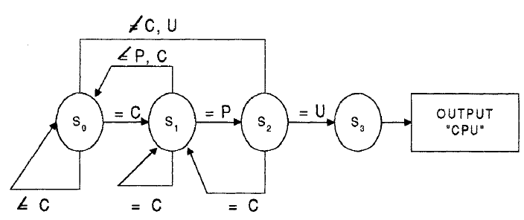
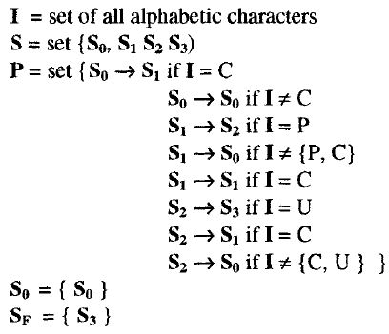
Finite State Automata
Automata Definition

Slide 12
SOFTWARE TEXT SEARCH ALGORITHMS
In software streaming techniques, the item to be searched is read into memory, and then the algorithm is applied.
There are four major algorithms associated with software text search:
The brute force approach
Knuth-Morris-Pratt
Boyer-Moore
Shift-OR algorithm, and Rabin-Karp

Slide 13
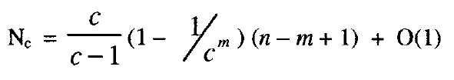
BRUTE FORCE APPROACH
The brute force approach is the simplest string matching algorithm.
The idea is to match the search string against the input text. Whenever a mismatch is detected in the comparison process, the input text is shifted one position, and the comparison process is initialized and restarted. The expected number of comparisons when searching an input text string of n characters for a pattern of m characters is
where Nc is the expected number of comparisons and c is the size of the alphabet for the text.

Slide 14
For search of any large streams the number of comparisons can be estimated by the number of characters being searched. For smaller items the length of the text pattern (m) can have an effect on the number of comparisons.
The Knuth-Pratt-Morris algorithm made a major improvement in brute force algorithms in that even in the worst case it does not depend upon the length of the search term and does not require comparisons for every character in the input stream.

Slide 15
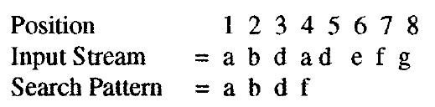
KNUTH-PRATT-MORRIS
The basic concept behind the algorithm is that whenever a mismatch is detected, the previous matched characters define the number of characters that can be skipped in the input stream prior to starting the comparison process again.
Example:
The algorithm allows the comparison to jump at least tile three positions associated with the recognized "a b d".

Slide 16
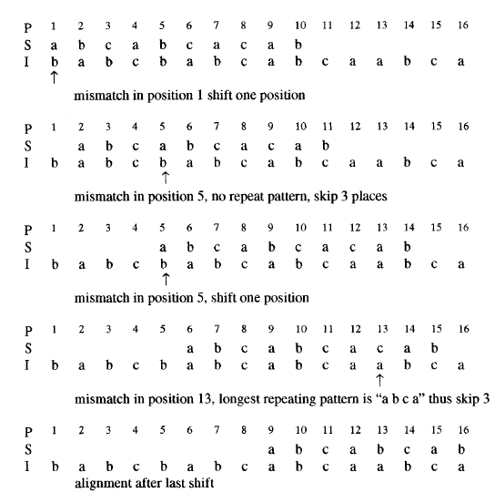
Search pattern = abcabcacab.
Example of Knuth-Morris-Pratt Algorithm

Slide 17
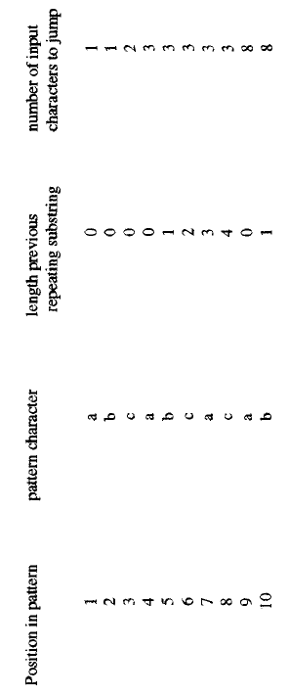
SHIFT CHARACTERS TABLE

Slide 18
BOYER-MOORE ALGORITHM
Boyer-Moore recognized that the string algorithm could be significantly enhanced if the comparison process starts at the end of the search pattern, processing right to left versus the start of the search pattern. The advantage is that large jumps are possible when the mismatched character in the input stream does not exist in the search pattern which occurs frequently.
This leads to two possible sources of determining how many input characters to be jumped. As in the Knuth- Morris-Pratt technique, any characters that have been matched in the search pattern require an alignment with that substring. Additionally, the character in the input stream that was mismatched also requires alignment with its next occurrence in the search pattern or the complete pattern can be moved. This can be defined as:

Slide 19
ALGOl - on a mismatch, the character in the input stream is compared to the search pattern to determine the shifting of the search pattern (number of characters in input stream to be skipped) to align the input character to a character in the search pattern. If the character does not exist in the search pattern then it is possible to shift the length of the search pattern matched to that position.
ALGO2 - on a mismatch occurring with a previous matching on a substring in the input text, the matching process can jump to the repeating occurrence in the pattern of the initially matched sub pattern - thus aligning that portion of the search pattern that is in the input text.

Slide 20
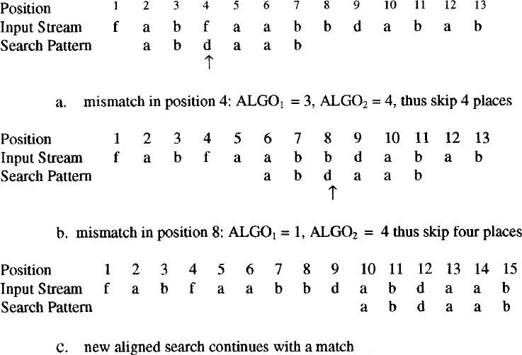
Upon a mismatch, the comparison process can skip the MAXIMUM (ALGO1,ALGO2).

Slide 21
The comparison starts at the right end of the search pattern and works towards the start of the search pattern.
The original Boyer-Moore algorithm has been the basis for additional text search techniques. It was originally designed to support scanning for a single search string. It was expanded to handle multiple search strings on a single pass.

Slide 22
Another approach based upon Knuth-Pratt-Morris uses a finite state machine to process multiple query terms.
The pattern matching machine consists of a set of states. The machine processes the input text by successively reading in the next symbol and, based upon the current state, makes the state transitions while indicating matches when they occur. The machine's operation is based upon three functions:
1. GOTO (i.e., state transition)
2. a failure function and a
3. output function.

Slide 23
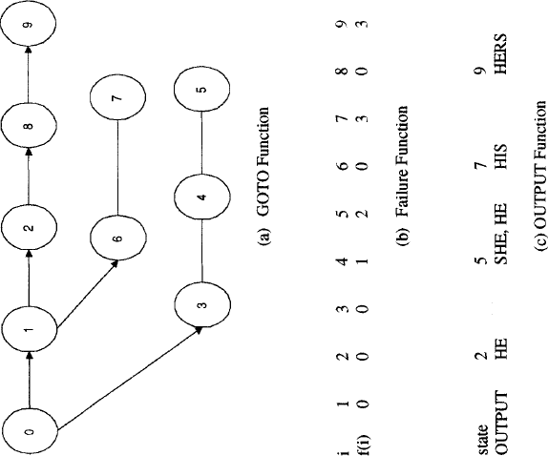

Slide 24
BAEZA-YATES AND GONNET APPROACH
handle "don't care" symbols and complement symbols
The search also handles tile cases of up to k mismatches. Their approach uses a vector of m different states, where m is the length of tile search pattern, and state i gives the state of the search between the positions 1 . . . . . i of the pattern and positions (j - i + 1) . . . . . j of the text where j is the current position in the text.

Slide 25
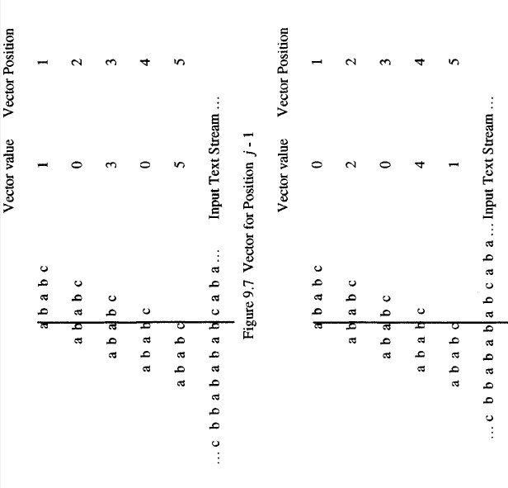

Slide 26
HARDWARE TEXT SEARCH SYSTEMS
The searcher is hardware based, scalability is achieved by increasing the number hardware search devices. The only limit on speed is the time it takes to flow the text off secondary storage (i.e., disk drives) to the searchers.
By having one search machine per disk, the maximum time it takes to search a database of any size is the time to search one disk.

Slide 27
ADVANTAGES
the disks were formatted to optimize the data flow off of the drives.
Another major advantage of using a hardware text search unit is in the elimination of the index that represents the document database.

Slide 28
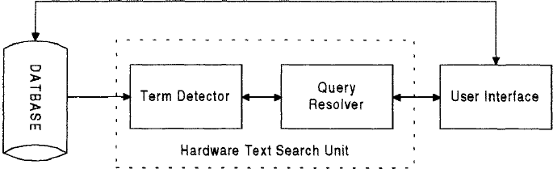
APPROACH-1
Specialized hardware that interfaces with computers and is used to search secondary storage devices was developed from the early 1970s with the most recent product being the Parasel Searcher (previously the Fast Data Finder).
The need for this hardware was driven by the limits in computer resources. The typical hardware configuration is shown in Figure in the dashed box. The speed of search is then based on the speed of the I/O.

Slide 29
One of the earliest hardware text string search units was the Rapid Search Machine developed by General Electric(GE).
The machine consisted of a special purpose search unit in which a single query was passed against a magnetic tape containing the documents.
A more sophisticated search unit was developed by Operating Systems Inc. called the Associative File Processor (AFP).
It is capable of searching against multiple queries at the same time. Following that initial development, OSI, using a different approach, developed the High Speed Text Search (HSTS) machine.

Slide 30
It uses an algorithm similar to the Aho-Corasick software finite state machine algorithm except that it runs three parallel state machines.
One state machine is dedicated to contiguous word phrases
Another for imbedded term match and the final for exact word match. In parallel with that development effort, GE redesigned their Rapid Search Machine into the GESCAN unit.
TRW, based upon analysis of the HSTS, decided to develop its own text search unit. This became the Fast Data Finder, now being marketed by Parasal.
All of these machines were based upon state machines that input the text string and compared them to the query terms.

Slide 31
The GESCAN system uses a text array processor (TAP) that simultaneously matches many terms and conditions against a given text stream.
The TAP receives the query information from the user's computer and directly accesses the textual data from secondary storage.
The TAP consists of a large cache memory and an array of four to 128 query processors.
Each query processor is independent and can be loaded at any time. A complete query is handled by each query processor. Queries support exact term matches, fixed length don't cares, variable length "don't cares," terms restricted to specified zones, Boolean logic, and proximity.

Slide 32
A query processor works two operations in parallel:
Matching query terms to input text
Term matching is performed by a series of character cells, each containing one character of the query. A string of character cells is implemented on the same LSI chip and the chips can be connected in series for longer strings. When a word or phrase of the query is matched, a signal is sent to the resolution sub-process on the LSI chip.
Boolean logic resolution
The resolution chip is responsible for resolving the Boolean logic between terms and proximity requirements. If the item satisfies the query, the information is transmitted to the user's computer.

Slide 33
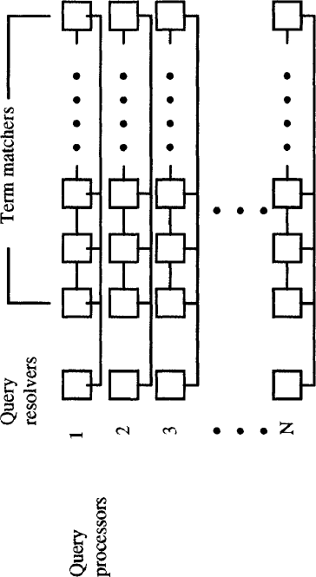
GESCAN Text Army Processor

Slide 34
Each row of the matrix is a query processor in which the first chip performs the query resolution while the remaining chips match query terms.
The maximum number of characters in a query is restricted by the length of a row while the number of rows limit the number of simultaneous queries that can be processed.

Slide 35
APPROACH-2
Another approach
for hardware searchers is to
augment disc storage. The augmentation is
a
generalized associative search element placed between the read and write heads on the disk.
The content addressable segment sequential memory (CASSM) system (Roberts-78) uses these search elements in parallel to obtain structured data from a database.
The CASSM system was developed at the University of Florida as a general purpose search device (Copeland-73). It can be used to perform string searching across the database.

Slide 36
APPROACH-3
The Fast Data Finder (FDF) is the most recent specialized hardware text search unit still in use in many organizations. It was developed to search text and has been used to search English and foreign languages.
The early Fast Data Finders consisted of an array of programmable text processing cells connected in series forming a pipeline hardware search processor.
The cells are implemented using a VSLI chip. In the TREC tests each chip contained 24 processor cells with a typical system containing 3600 cells (the FDF-3 has a rack mount configuration with 10,800 cells).
Each cell is a comparator for a single character, limiting the total number of characters in a query to the number of cells. The cells are interconnected with an 8-bit data path and approximately 20-bit control path.
The text to be searched passes through each cell in a pipeline fashion until the complete database has been searched.

Slide 37
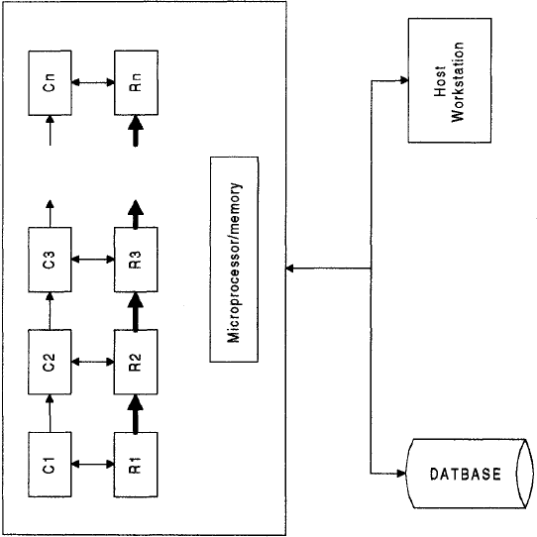
Fast Data Finder Architecture

Slide 38
A cell is composed of both a register cell (Rs) and a comparator (Cs).
The input from the Document database is controlled and buffered by the microprocessor/memory and feed through the comparators.
The search characters are stored in the registers.
The connection between the registers reflects the control lines that are also passing state information.
Groups of cells are used to detect query terms, along with logic between the terms, by appropriate programming of the control lines.
When a pattern match is detected, a hit is passed to the internal microprocessor that passes it back to the host processor, allowing immediate access by the user to the Hit item.

Slide 39
The functions supported by the Fast Data Finder are
Boolean Logic including negation
Proximity on an arbitrary pattern
Variable length "don't cares"
Term counting and thresholds
Fuzzy matching
Term weights
Numeric ranges.

Slide 40
INFORMATION SYSTEM EVALUATION:
Introduction
Measures used in system evaluation
Measurement example – TREC results.

Slide 41


Search
Inf. need
Results
User
Evaluation

Slide 42
INTRODUCTION TO INFORMATION SYSTEM EVALUATION
The evaluations focused primarily on the effectiveness of search algorithms. The creation of the annual Text Retrieval Evaluation Conference (TREC) sponsored by the Defense Advanced Research Projects Agency (DARPA) and the National Institute of Standards and Technology (NIST) changed the standard process of evaluating information systems.
Conferences have been held every year, starting from 1992, usually in the Fall months. The conference provides a standard database consisting of gigabytes of test data, search statements and the expected results from the searches to academic researchers and commercial companies for testing of their systems.

Slide 43
In recent years the evaluation of Information Retrieval Systems and techniques for indexing, sorting, searching and retrieving information have become increasingly important.
This growth in interest is due to two major reasons: the growing number of retrieval systems being used and additional focus on evaluation methods themselves.

Slide 44
There are many reasons to evaluate the effectiveness of an Information Retrieval System (Belkin-93, Callan-93):
To aid in the selection of a system to procure
To monitor and evaluate system effectiveness
To evaluate query generation process for improvements
To provide inputs to cost-benefit analysis of an information system
To determine the effects of changes made to an existing information System

Slide 45
EVALUATION CRITERIA
Effectiveness
System-only, human+system
Efficiency
Retrieval time, indexing time, index size
Usability
Learnability, novice use, expert use

Slide 46
From an academic perspective, measurements are focused on the specific effectiveness of a system and usually are applied to determining the effects of changing a system's algorithms or comparing algorithms among systems.
From a commercial perspective, measurements are also focused on availability and reliability.
The most important evaluation metrics of information systems will always be biased by human subjectivity.
This problem arises from the specific data collected to measure the user resources in locating relevant information

Slide 47
A factor in most metrics in determining how well a system is working is the relevancy of items.
Relevancy of an item, however, is not a binary evaluation, but a continuous function between an item's being exactly what is being looked for and its being totally unrelated.
Relevancy, it is necessary to define the context under which the concept is used. From a human judgment standpoint, relevancy can be considered:
Subjective
Situational
Cognitive behavior
Temporal
Measurable
-
-
-
depends upon a specific user's judgment relates to a user's requirements
depends on human perception and
changes over time
observable at a points in time
-
-

Slide 48
In a dynamic environment, each user has his own understanding of the requirement and the threshold on what is acceptable. Based upon his cognitive model of the information space and the problem, the user judges a particular item. Some users consider information they already know to be non-relevant to their information need.
Example: User being presented with an article that the user wrote does not provide "new" relevant information to answer the user's query, although the article may be very relevant to the search statement. Also the judgment of relevance can vary over time. Retrieving information on an "XT" class of PCs is not of significant relevance to personal computers in 1996, but would have been valuable in 1992. Thus, relevance judgment is measurable at a point in time constrained by the particular users and their thresholds on acceptability of information.

Slide 49
Another way of specifying relevance is from information, system and situational views.
1. Information View
The information view is subjective in nature and pertains to human judgment of the conceptual relatedness between an item and the search.
It involves the user's personal judgment of the relevancy (aboutness) of the item to the user's information need.
When reference experts (librarians, researchers, subject specialists, indexers) assist the user, it is assumed they can reasonably predict whether certain information will satisfy the user's needs.

Slide 50
Ingwersen categorizes the information view into four types of "aboutness” (Ingwersen-92):.
Author Aboutness - determined by the author's language as matched by the system in natural language retrieval
Indexer Aboutness - determined by the indexer's transformation of the author' s natural language into a controlled vocabulary
Request Aboutness - determined by the user's or intermediary's processing of a search statement into a query
User Aboutness - determined by the indexer's attempt to represent the document according to presupposition about what the user will want to know

Slide 51
2. System View
The system view relates to a match between query terms and terms within an item. It can be objectively observed, manipulated and tested without relying on human judgment because it uses metrics associated with the matching of the query to the item (Barry-94, Schamber-90).
The semantic relatedness between queries and items is assumed to be inherited via the index terms that represent the semantic content of the item in a consistent and accurate fashion.

Slide 52
3.The Situation View
The situation view pertains to the relationship between information and the user's information problem situation. It assumes that only users can make valid judgments regarding the suitability of information to solve their information need.
Lancaster and Warner refer to information and situation views as relevance and pertinence respectively (Lancaster-93). Pertinence can be defined as those items that satisfy the user's information need at the time of retrieval.

Slide 53
MEASURES USED IN SYSTEM
EVALUATIONS
To define the measures that can be used in evaluating Information Retrieval Systems, it is useful to define the major functions associated with identifying relevant items in an information system.
Items arrive in the system and are automatically or manually transformed by "indexing" into searchable data structures.
The user determines what his information need is and creates a search statement. The system processes the search statement, returning potential hits. The user selects those hits to review and accesses them.

Slide 54
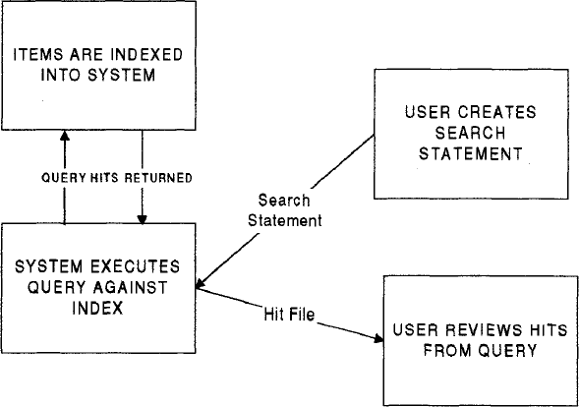
Identifying Relevant Items

Slide 55
Measurements can be made from two perspectives:
User Perspective and
System Perspective

Slide 56
1.User Perspective
Author Aboutness - determined by the author's language as matched by the system in natural language retrieval
Indexer Aboutness - determined by the indexer's transformation of the author' s natural language into a controlled vocabulary
Request Aboutness - determined by the user's or intermediary's processing of a search statement into a query
User Aboutness - determined by the indexer's attempt to represent the document according to presupposition about what the user will want to know

Slide 57
2.System Perspective
Based upon aggregate functions, whereas the user takes a more personal view.
If a user's PC is not connecting to the system, then, from that user's view the system is not operational.
Techniques for collecting measurements can also be objective or subjective.
An objective measure is one that is well-defined and based upon numeric values derived from the system operation.
A subjective measure can produce a number, but is based upon an individual users judgments.

Slide 58
EVALUATIONS
MEASURES ASSOCIATED IN SYSTEM
Search Process
Response Time
Consistency
Quality of the Search
Fallout
Unique Relevance Recall( URR )
Novelty Ratio
Coverage Ratio
Sought Recall

Slide 59
SEARCH PROCESS
This is associated with a user creating a new search or modifying an existing query. In creating a search, an example of an objective measure is the time required to create the query, measured from when the user enters into a function allowing query input to when the query is complete.
Completeness is defined as when the query is executed. Although of value, file possibilities for erroneous data (except in controlled environments) are so great that data of this nature are not collected in tiffs area in operational systems.
Example: The erroneous data comes from the user performing other activities in the middle of creating the search such as going to get a cup of coffee.

Slide 60
RESPONSE TIME
Response time is a metric frequently collected to determine the efficiency of the search execution. Response time is defined as the time it takes to execute the search. The ambiguity in response time originates from the possible definitions of file end time.
The beginning is always correlated to when the user tells the system to begin searching. The end time is affected by the difference between the user's view and a system view. From a user's perspective, a search could be considered complete when file first result is available for tile user to review, especially if the system has new items available whenever a user needs to see tile next item. From a system perspective, system resources are being used until the search has determined all hits.

Slide 61
CONSISTENCY
To ensure consistency, response time is usually associated with the completion of the search. This is one of the most important measurements in a production system. Determining how well a system is working answers the typical concern of a user: "the system is working slow today.“
It is difficult to define objective measures on the process of a user selecting hits for review and reviewing them. The problems associated with search creation apply to this operation.
Using time as a metric does not account for reading and cognitive skills of the user along with the user performing other activities during the review process.
Data are usually gathered on the search creation and Hit file review process by subjective techniques, such as questionnaires to evaluate system effectiveness.

Slide 62
QUALITY OF THE SEARCH
In addition to efficiency of the search process, the quality of the search results are also measured by precision and recall.
Precision is a measure of the accuracy of the search process. It directly evaluates the correlation of the query to the database and indirectly is a measure of the completeness of the indexing algorithm.
If tile indexing algorithm tends to generalize by having a high threshold on the index term selection process or by using concept indexing, then precision is lower, no matter how accurate tile similarity algorithm between query and index.
Recall is a measure of the ability of tile search to find all of the relevant items that are in the database.

Slide 63


where Number Possible_Relevant is the number of relevant items in the database, Number_Retrieved_Relevant is the number of relevant items in the Hit file, and Number_Total_Retrieved is the total number of items in the Hit File.
Number_Retrieved_Relevant and Number_Total_Retrieved, are always available. Number_Possible-Relevant poses a problem in uncontrolled environments because it suggests that all relevant items in the database are known.

Slide 64
To gain the insights associated with testing a search against a large database makes collection of this data almost impossible. Two approaches have been suggested. The first is to use a sampling technique across the database and performing relevance judgments on the returned items.
The other technique is to apply different search strategies to the same database for the same query. An assumption is then made that all relevant items in the database will be found in the aggregate from all of the searches

Slide 65

FALLOUT
Another measure that is directly related to retrieving non-relevant items can be used in defining how effective an information system is operating. This measure is called Fallout and defined as
where Number_Total_Nonrelevant is the total number of non-relevant items in the database. Fallout can be viewed as the inverse of recall and will never encounter the situation of 0/0 unless all the items in the database are relevant to the search. It can be viewed as the probability that a retrieved item is non-relevant.

Slide 66
From a system perspective, the ideal system demonstrates maximum recall and minimum fallout.
This combination implicitly has maximum precision. Of the three measures (precision, recall and fallout), fallout is least sensitive to the accuracy of the search process.
The large value for the denominator requires significant changes in the number of retrieved items to affect the current value.

Slide 67

UNIQUE RELEVANCE RECALL(URR)
URR is used to compare more two or more algorithms or systems. It measures the number of relevant items that are retrieved by one algorithm that are not retrieved by the others:

Slide 68
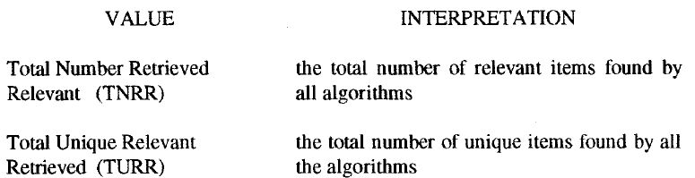
Number_unique_relevant is the number of relevant items retrieved that were not retrieved by other algorithms.
When many algorithms are being compared, the definition of uniquely found items for a particular system can be modified, allowing a small number of other systems to also find the same item and still be considered unique.
This is accomplished by defining a percentage (Pu) of the total number of systems that can find an item and s011 consider it unique. Number_relevant can take on two different values based upon the objective of the evaluation:

Slide 69
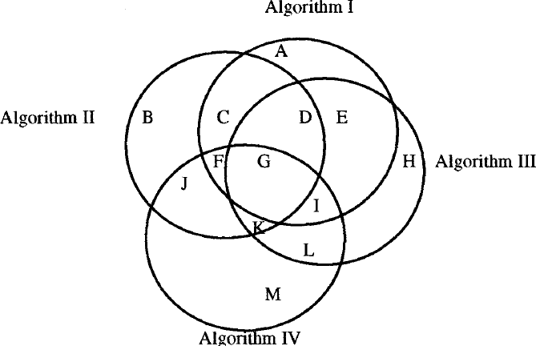
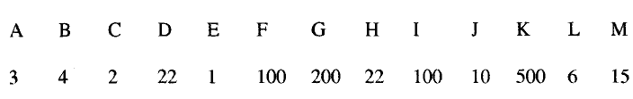
Example
Four Algorithms With Overlap of Relevant Retrieved
Number Relevant Items

Slide 70
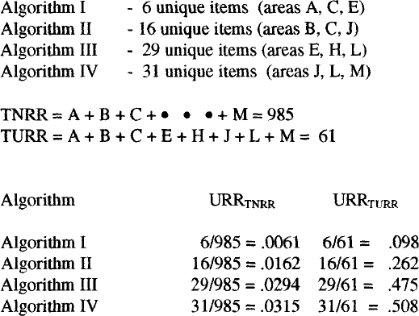
From the diagram the following values URR values can be produced:

Slide 71
The URR value is used in conjunction with Precision,
Recall and Fallout to determine the
total other
effectiveness of an algorithm compared to algorithms.
The results indicate that if we wanted to increase my recall by running two algorithms, choose algorithm III or IV in addition to the algorithm with the highest recall value(47.5, 50.8).

Slide 72
Novelty Ratio: ratio of relevant and not known to the user to total relevant retrieved
Coverage Ratio: ratio of relevant items retrieved to total relevant by the user before the search
Sought Recall: ratio of the total relevant reviewed by the user after the search to the total relevant the user would have liked to examine

Slide 73
MEASUREMENT EXAMPLE – TREC RESULTS
CHECK THE TEXT BOOK FOR MEASUREMENTS OF TREC ON DIFFERENT DATABASES.

